Slide 1

PMI LOGISTIC SYSTEM IMPROVEMENT PROPOSAL FOR EMERGENCY WAREHOUSE
BUSINESS INTELLIGENCE
22.10.2021

Slide 2

Agenda
INTRODUCTION
DATA ANALYSIS
PROJECT MOTIVATION
SOLUTION
WHAT’S NEXT
SUMMARY

Slide 3

INTRODUCTION
MOHAMMAD RUSDIANTO
Experience : Automotive Industry (Proc. Manager)
Business process, Manufacturing process, Cost
Analysis, Negotiation, VA/VE
Education : Mechanical Engineering
Skill : Procurement system, Cost Analysis, & Business Intelligence
Interest : Business, Psychology, Artificial Intelligence, and Automotive

Slide 4

Data analysis
Let’s Dive In

Slide 5
DATA PREPROCESSING
DATA CLEANSING
MISSING VALUE
(Weight, price, etc)
Misclassification
FEATURE ENGINEERING
Stock status data
Donor province of origin & destination
NOTIFICATION
Since no individual tag for each product, expired product data can’t be generated or simulated
Since no minimum stock data, critical stock information can’t be generated
Not all analysis and control points can be provided from current data set

Slide 6
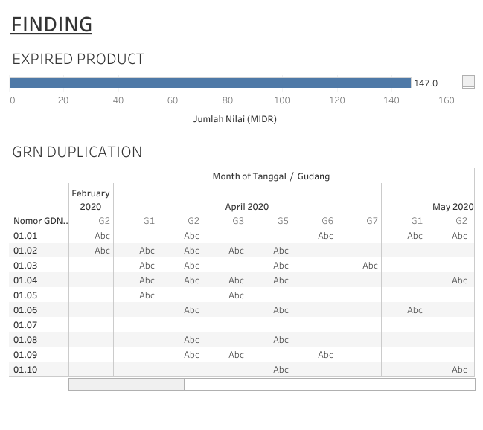
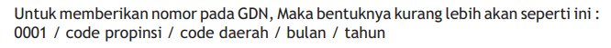
EXPLORATORY DATA ANALYSIS
There’re duplication of GRN / GDN at different month and different warehouse within same period.
If these cases are abnormal cases then this must be improved
If the duplication are really true then these could lead difficulty to manage FEFO and FIFO since no reliable update in the system
In the end it would cause expired product undetected
NOT STANDARDIZED GRN/GDN NUMBER
PMI Logistic manual provides numerical standard for GRN/GDN number which not applied in dataset.

Slide 7
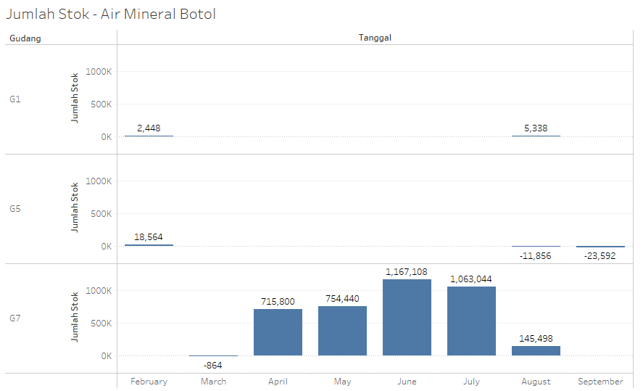
EXPLORATORY DATA ANALYSIS
UNCLEAR STOCK DATA BASE
The data shows that receiving initially proceed in Warehouse G1 & G5, but in the middle there’re no stock at those warehouse.
Initial stock at warehouse G7 start at minus position.
This could be happened due to the stocks were moved from G1 & G5 to G7 or just simply mistype issue.
This could create a problem in monitoring the stock, FIFO and FEFO are not running well, in the end it would cause expire stock or difficult to find the stock.

Slide 8
EXPLORATORY DATA ANALYSIS
There’re 147 MIDR expired product from Warehouse G4 [5.9 MIDR] & G5 [141 MIDR] in period from Oct’20 – Apr’21
If these waste are found during keeping / storing then this must be improved
NO EXPIRY DATE INFORMATION IN DATA SET
This could happen due to no input in the system or just the information has not been given to us
If this happen due to unstandardized process, means that no control to expiry date of product
NO INDIVIDUAL TAG
This would create difficulty to confirm FIFO and FEFO

Slide 9
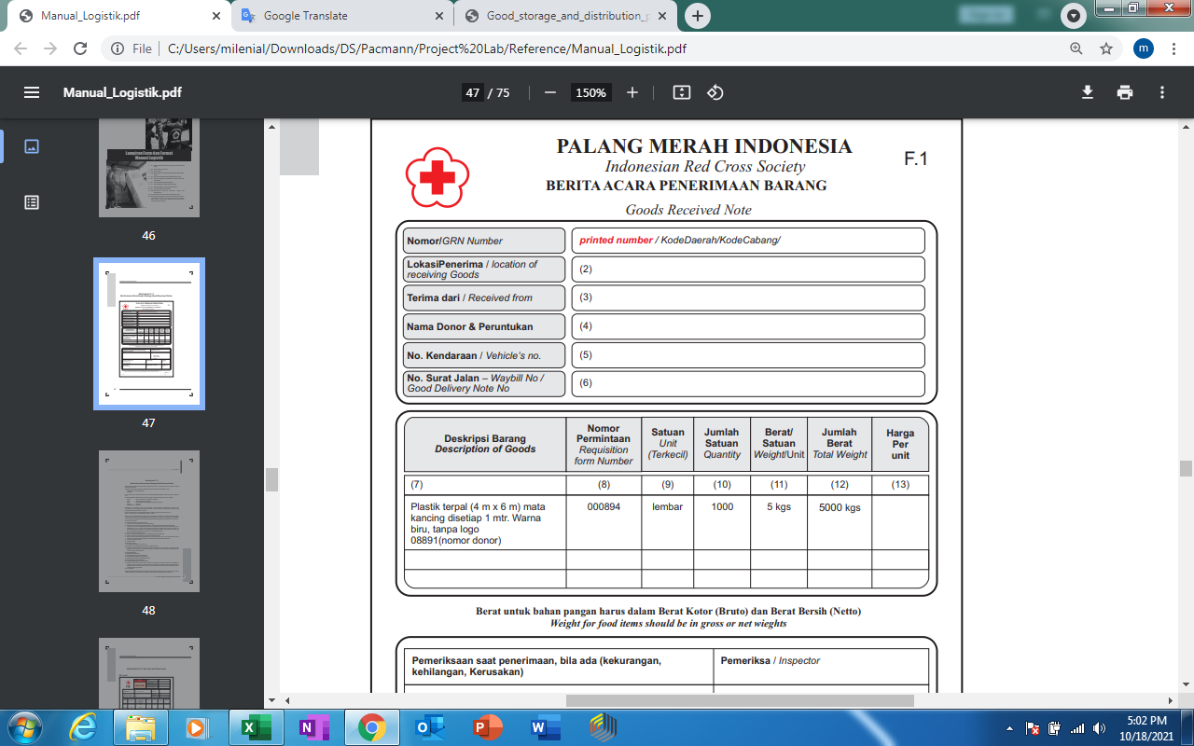
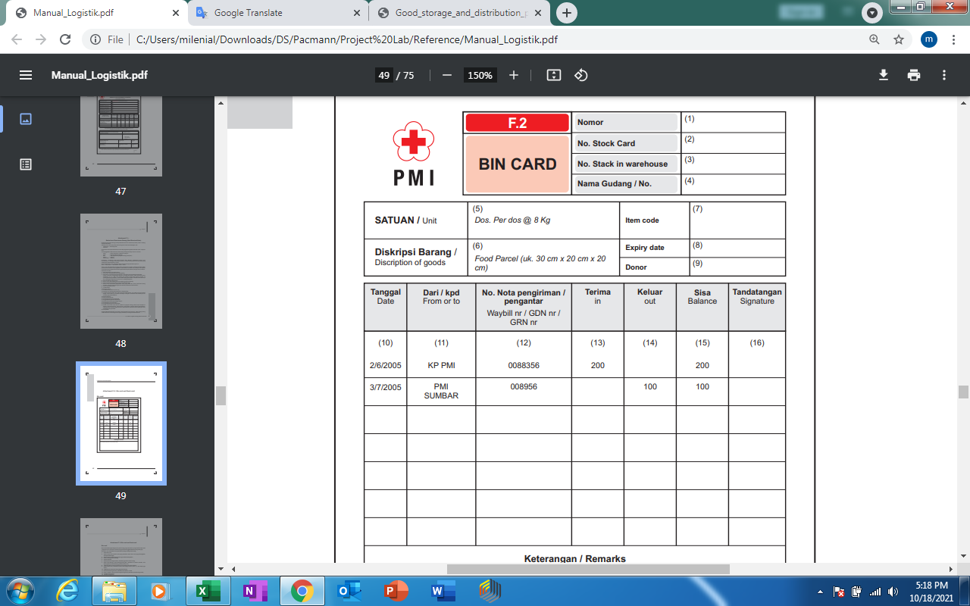
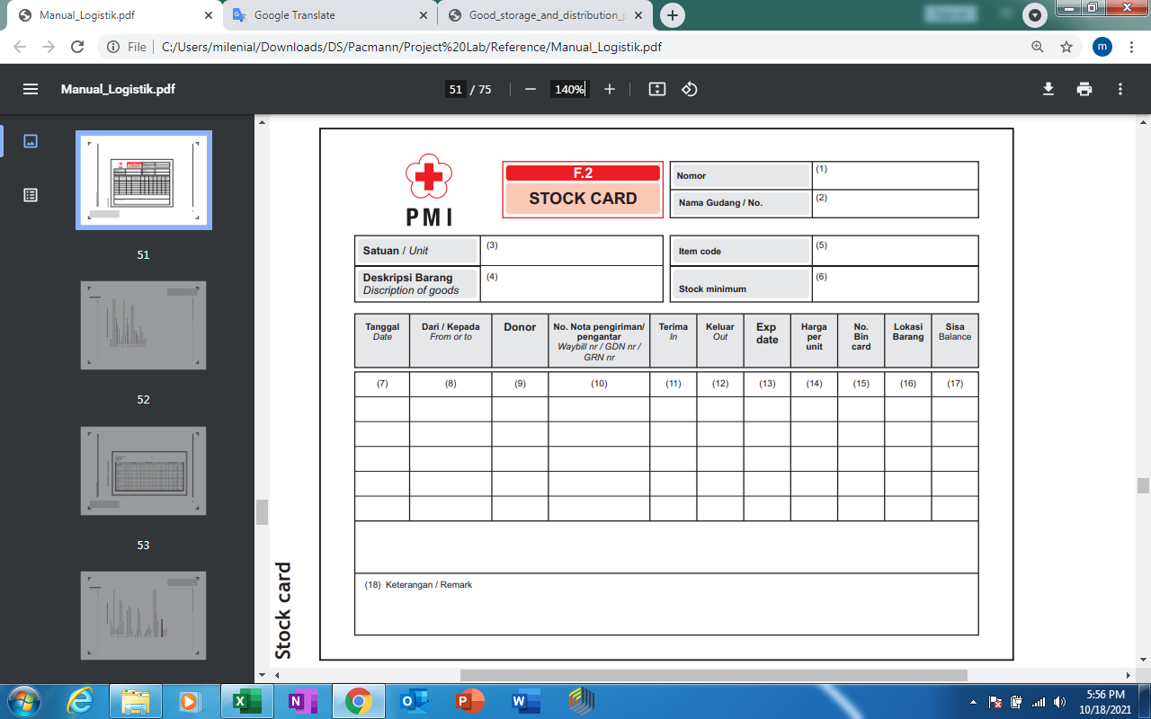
POSITIVE FINDING
PMI has standardized form to control stock from receiving, keeping, until dispatching.
These information should be enough to control the stock movement
However these are completely manual and full-paper administration, risk of human error in huge job load

Slide 10
GOOD STORING & DISTRIBUTION PRACTICES
RECOMMENDATION - WHO
KEY TOPICS | KEY POINTS | CORRELATION WITH PROJECT
Quality Management | Clear SOP, risk identification, effective control, system to manage “change, deviation, corrective, and prevention action” | Flow process & SOP
Quality Risk Management | System to assess, control, communicate and review risks identified at all stages in the supply chain | Monitored items
Self-inspection | Self-inspections should be conducted periodically according to an annual schedule | Internal audit
Stock Control & Rotation | Periodic stock reconciliation, All stocks should be checked regularly for obsolete and expired materials and products | Stock update and identification
Equipment | Computerized systems should be capable of achieving the desired output and results | Database & visualization dashboard
Documentation | Documentation includes all procedures and records, whether in paper or electronic form | Standardized form, SOP, etc

Slide 11
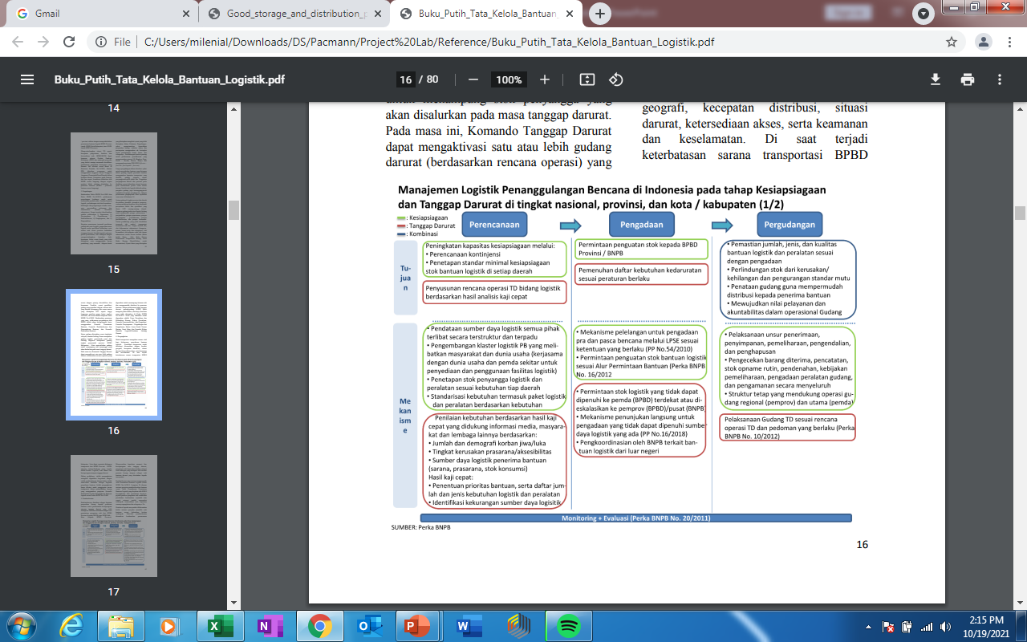
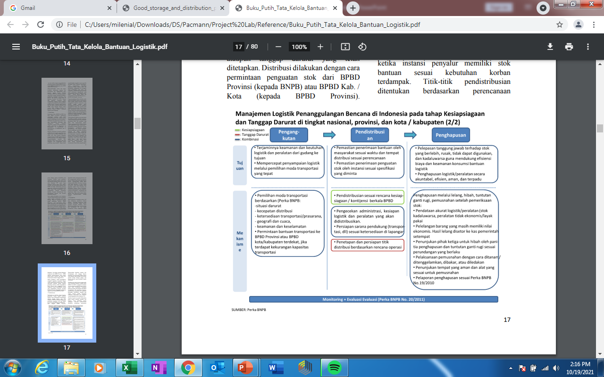
Disasters logistic management
A RECOMMENDATION FOR BNPB
Planning start from predicting or determining disaster location, population estimation, list of products needed with quantity
Continue with PMI Warehouse planning

Slide 12
motivation
To STRENGTHEN TRANSPARENCY AND ACCOUNTABILITY of PMI by Enhancing logistic system, to control and monitor stock movement from receiving, keeping / storing, and distribution / dispatch. The output will be taken at decision making process (Manual Logistik PMI).

Slide 13
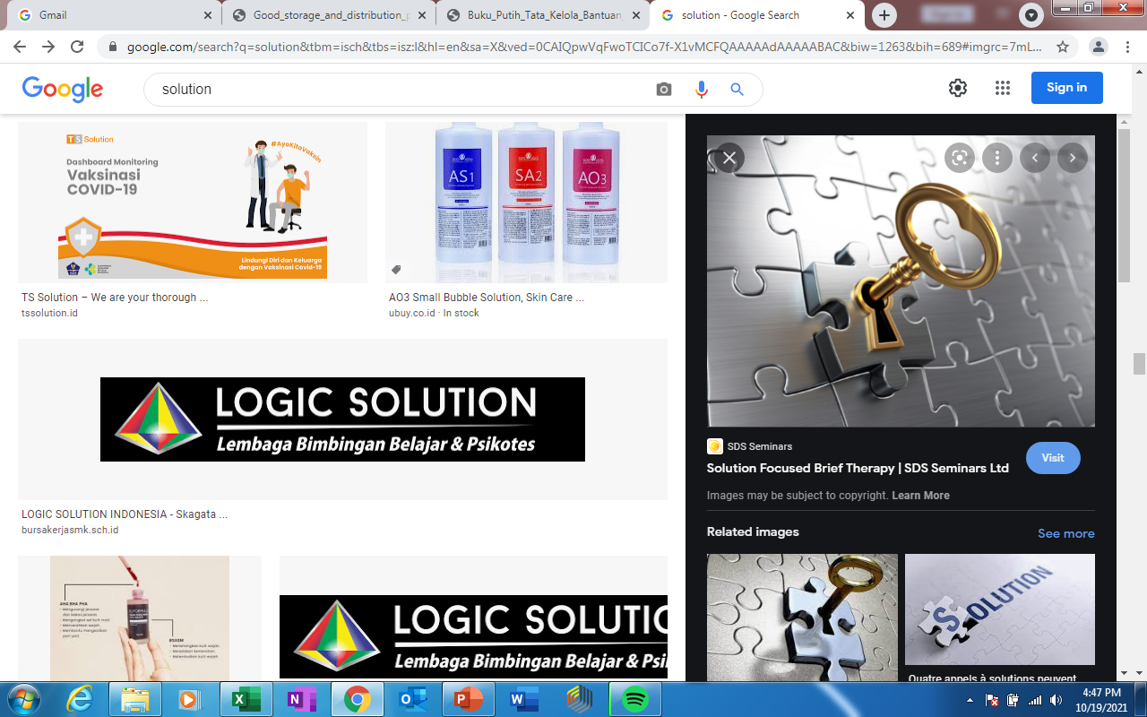
SOLUTION
Let’s Dive In

Slide 14
Balanced scorecard slide 4
IMPROVEMENT PROPOSAL
OVERVIEW
BACK TO STANDARD
Make sure all SOP and standard process flow in PMI logistic manual applied
DATABASE IMPROVEMENT
To reduce input process
Auto print for Bin Card & Stock Card
Consistent Database
VISUALIZATION
To ease monitoring process for quality control

Slide 15
Balanced scorecard slide 4
IMPROVEMENT PROPOSAL
DATA BASE IMPROVEMENT
CURRENT – From PMI Logistic Manual
GRN
[Paper]
BIN CARD
[Paper]
STOCK CARD
[Paper]
PROPOSAL
GRN
 | CURRENT | NEXT
INPUT (Fewer process) | GRN, GDN, BIN Card, Stock Card, Stock Report | GRN, GDN, and W/H Plan (Initial stage)
AUTO PROCESS | - | Stock Card Bin Card
Database
GDN
W/H Plan
Bin Card
Stock Card

Slide 16
Balanced scorecard slide 4
DASHBOARD PROPOSAL
MVP LIST
CATEGORY | PROCESS | MVP LIST | VALUE | WEIGHT | QTY | PROVINCE | W/H | PRODUCT | TIME | STATUS
GENERAL |  | Incoming donation by province | 1 | 1 |  | 1 |  |  |  | Applied
 |  | Outcoming donation by province | 1 | 1 |  | 1 |  |  |  | Applied
 |  | Total donation amount received | 1 | 1 |  | 1 |  |  |  | Applied
 |  | Total donation amount distributed | 1 | 1 |  | 1 |  |  |  | Applied
 |  | Incoming donation amount by product | 1 | 1 |  |  |  | 1 |  | Applied
 |  | Outcoming donation amount by product | 1 | 1 |  |  |  | 1 |  | Applied
 |  | Outcoming donation by monthly | 1 | 1 |  | 1 | 1 |  |  | Applied
LOGISTIC CONTROL | Incoming / Outcoming | Monthly receiving / distribution by product | 1 | 1 |  |  | 1 | 1 | 1 | Applied
 | Storing | Number of remaining stock by product |  | 1 |  |  | 1 | 1 | 1 | Applied
 | Storing | Critical stock by product |  | 1 |  |  | 1 | 1 | 1 | Postpone
 | Storing | Critical expired by product |  |  | 1 |  | 1 | 1 | 1 | Postpone
 | Outcoming | Expired or eliminated product by warehouse | 1 | 1 |  |  | 1 | 1 | 1 | Postpone

Slide 17
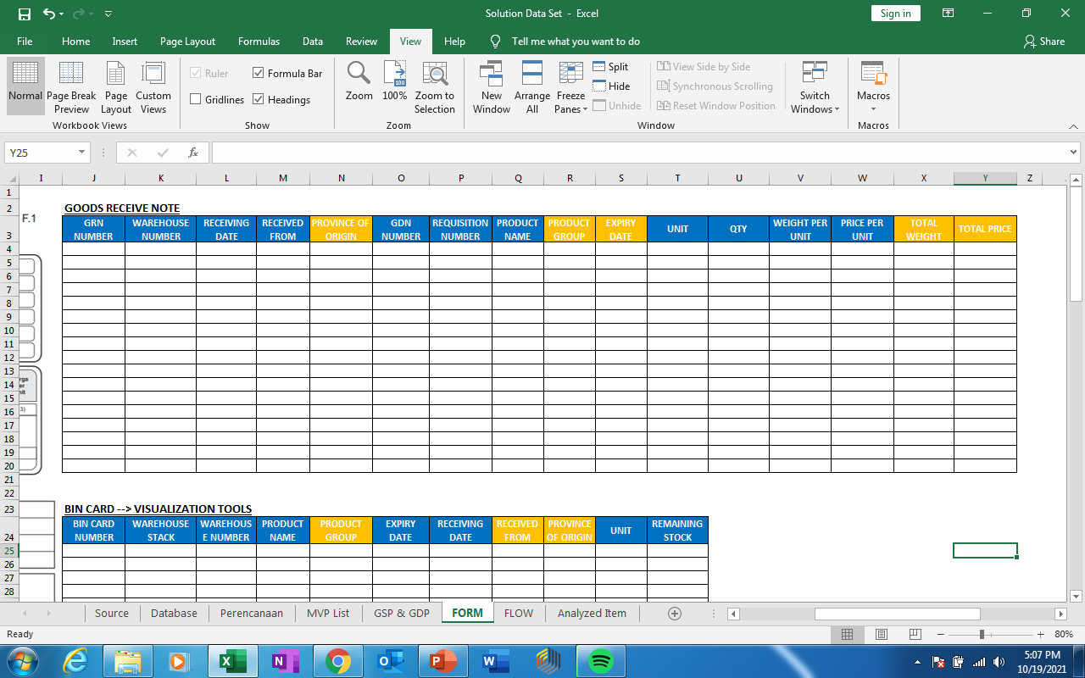
Balanced scorecard slide 4
PROPOSED DATA BASE

Slide 18
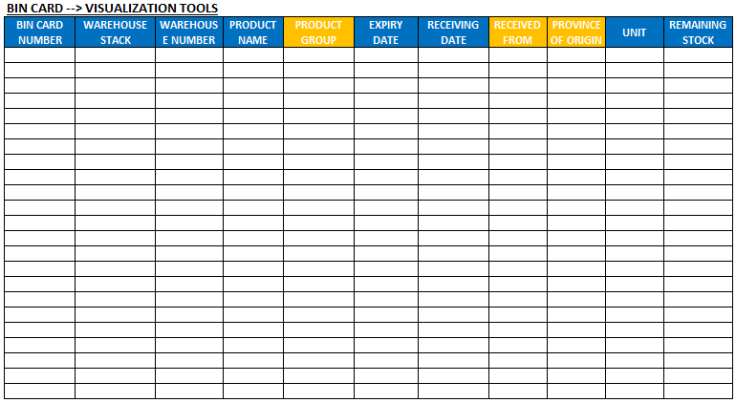
Balanced scorecard slide 4
PROPOSED DATA BASE

Slide 19
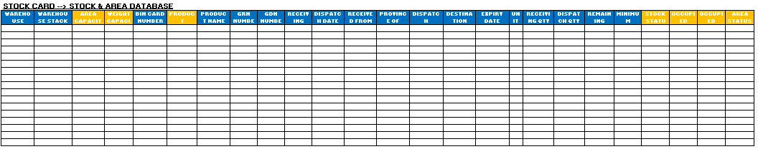
Balanced scorecard slide 4
PROPOSED DATA BASE

Slide 20
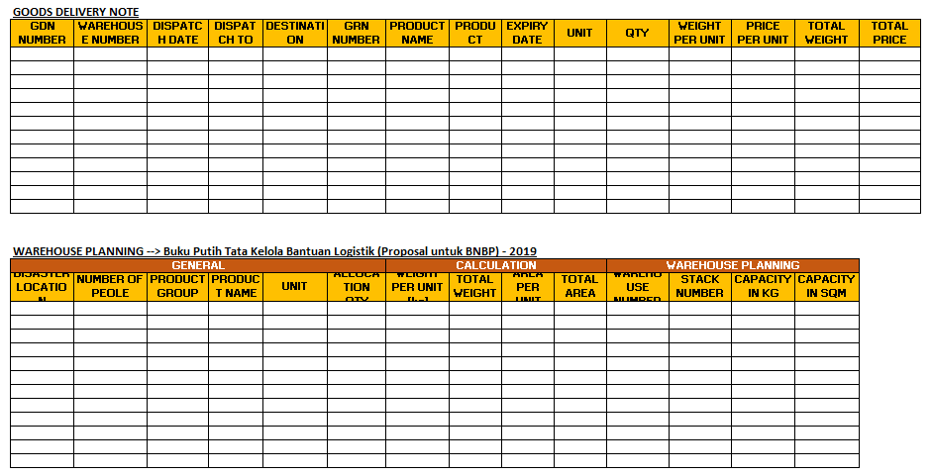
Balanced scorecard slide 4
PROPOSED DATA BASE

Slide 21
Balanced scorecard slide 4
PROPOSED DASHBOARD
https://public.tableau.com/views/PMI_Project_Final_1/Dashboard2?:language=en-US&publish=yes&:display_count=n&:origin=viz_share_link

Slide 22

What’s next
LOOKING AHEAD

Slide 23


Goals for NEXT IMPROVEMENT
COMPREHENSIVE
PREDICTION ANALYTICS
To establish synergy with related organization to provide end-to-end solution to strengthen vision and mission which stated at PMI RENSTRA 2019-2024
To have more data on in order to make comprehensive action plan start from buffer stock preparation, planning, execution, and control & monitoring.
To be able to provide prediction to anticipate more parameter for better analysis and management decision to enhance organization accountability through outstanding logistic management system and capability

Slide 24

SUMMARY
IMPROVEMENT OPPORTUNITY
There’re still findings that trigger us to improve our organization through improvement of logistic system
ORGANIZATION SCALE UP OPPORTUNITY
To establish a data driven organization to serve people better through technology
WE’RE DELIVERING FOR PEOPLE
#1 National Humanitarian-social Organization
#5 World Humanitarian-social Organization
TAKE MORE ROLES AND RESPONSIBILITY TO SAFE LIFE

Slide 25



THANK YOU
Mohammad Rusdianto
081804777007
shaqeela280515@gmail.com
BUSINESS INTELLIGENCE

